Slide 1
Periodic Table of Elements
Notes and Review
K. Spence

Slide 2
Essential Questions
How is matter organized?
How does matter differ in composition and properties?
How can you differentiate between types of matter qualitatively and quantitatively?
What methods and properties are used to organize elements?

Slide 3
Objectives:
Students will be able to:
  Explain how elements are organized.
  Distinguish between families and groups.
  Identify elements with similar properties.
  Label large groups of elements.
  Predict properties of the substance or position on the table based on given patterns.

Slide 4
Vocabulary:
Element- a single kind of atom
Atom- smallest, basic unit of matter
Period- Horizontal Rows on the periodic table
Group/Family- Vertical Columns; elements in the same group have the same number of electrons in the outer orbital; react in similar ways because they bond in similar ways
Atomic Number- number of protons in the atom
Atomic Mass- number of protons and neutrons in the atom (average mass of all atoms of that kind, including isotopes)

Slide 5
Element- Fundamental substances that cannot be broken down into simpler substances by normal chemical reactions.
      118 known elements
      92 Naturally occurring elements
      No Unknown elements under 110
Earth’s Crust Human Body
O 49.5% O 65%
Si 25.7% C 18%
Al 7.5% H 10%
Fe 4.7%

Slide 6
How would you organize so many elements?
Trends Activity
And
Mendeleyev Challenge

Slide 7
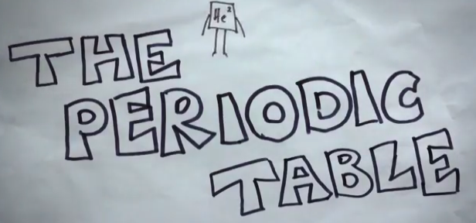
History of the Periodic Table - Youtube

Slide 8
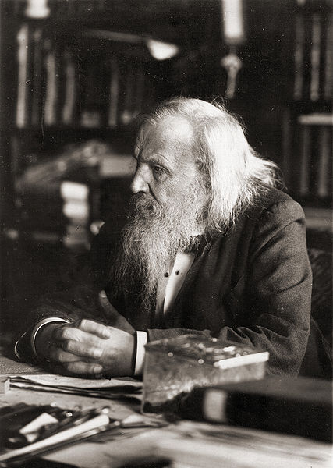
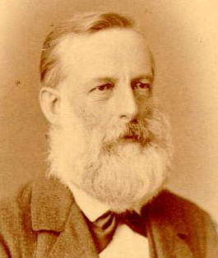
Periodic Table of Elements
Dmitri Mendeleev
Lothar Meyer

Slide 9
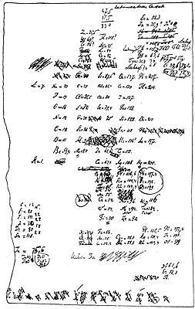
Periodic Table of Elements
A draft of Mendeleev’s first periodic table created in February 1869.
Lothar Meyer also published a table in 1870 but did not predict the existence of undiscovered elements.

Slide 10
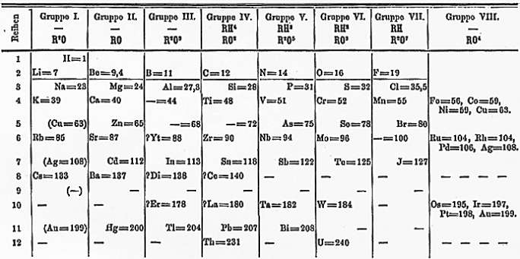
Periodic Table of Elements
Mendeleev’s first periodic table published in Zeitschrift für Chemie 12, 406-6 (1869)

Slide 11
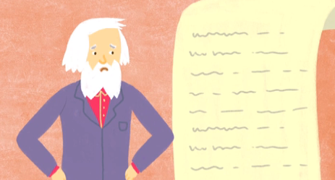
Importance of Mendeleev’s Table- Youtube

Slide 12
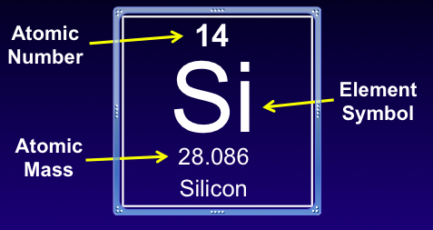
Modification to Mendeleev’s Table:
All atoms of the same element contain the same number of protons.
Atomic Number- number of protons in an atom.
Symbols: From Latin, Greek, or German
Always capitalize 1st Letter

Slide 14
Trends on the Periodic Table
Period- Horizontal Rows on the periodic table
Group/Family- Vertical Columns; elements in the same group have the same number of electrons in the outer orbital; react in similar ways because they bond in similar ways

Slide 16
Metals
Metal Properties
  Metallic, shiny/high luster
  Good Conductors of Heat and Electricity
  Malleable- can pound into sheets
  Ductile- can pull into wires
  High Density
  High Melting Point
  Solids at Room Temperature (except Mercury)
  Easily lose electrons

Slide 18
Non-Metals
Non-Metal Properties
    Dull in appearance (low luster)
    Not Malleable
    Not Ductile
    Poor Conductors of heat and electricity
    Many are gases at room temperature
    Solid non-metals are usually brittle
    More than 97% of your body is made of non-metals
    Tend to gain electrons

Slide 20
Metalloids
Metalloids
    Elements with intermediate properties.
    Have characteristics of metals and non-metals
    Some are shiny, some are dull
    Many are good conductors, but not as good as metals
    Border separation between metals and non-metals. ex. Al, Ge, As, Sb, Te…

Slide 21
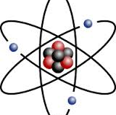

Pay Close Attention to Details and Labels… The actual colors don’t matter, but shading and different colors are necessary.
BE CAREFUL!!
Color the Periodic Table Activity

Slide 22
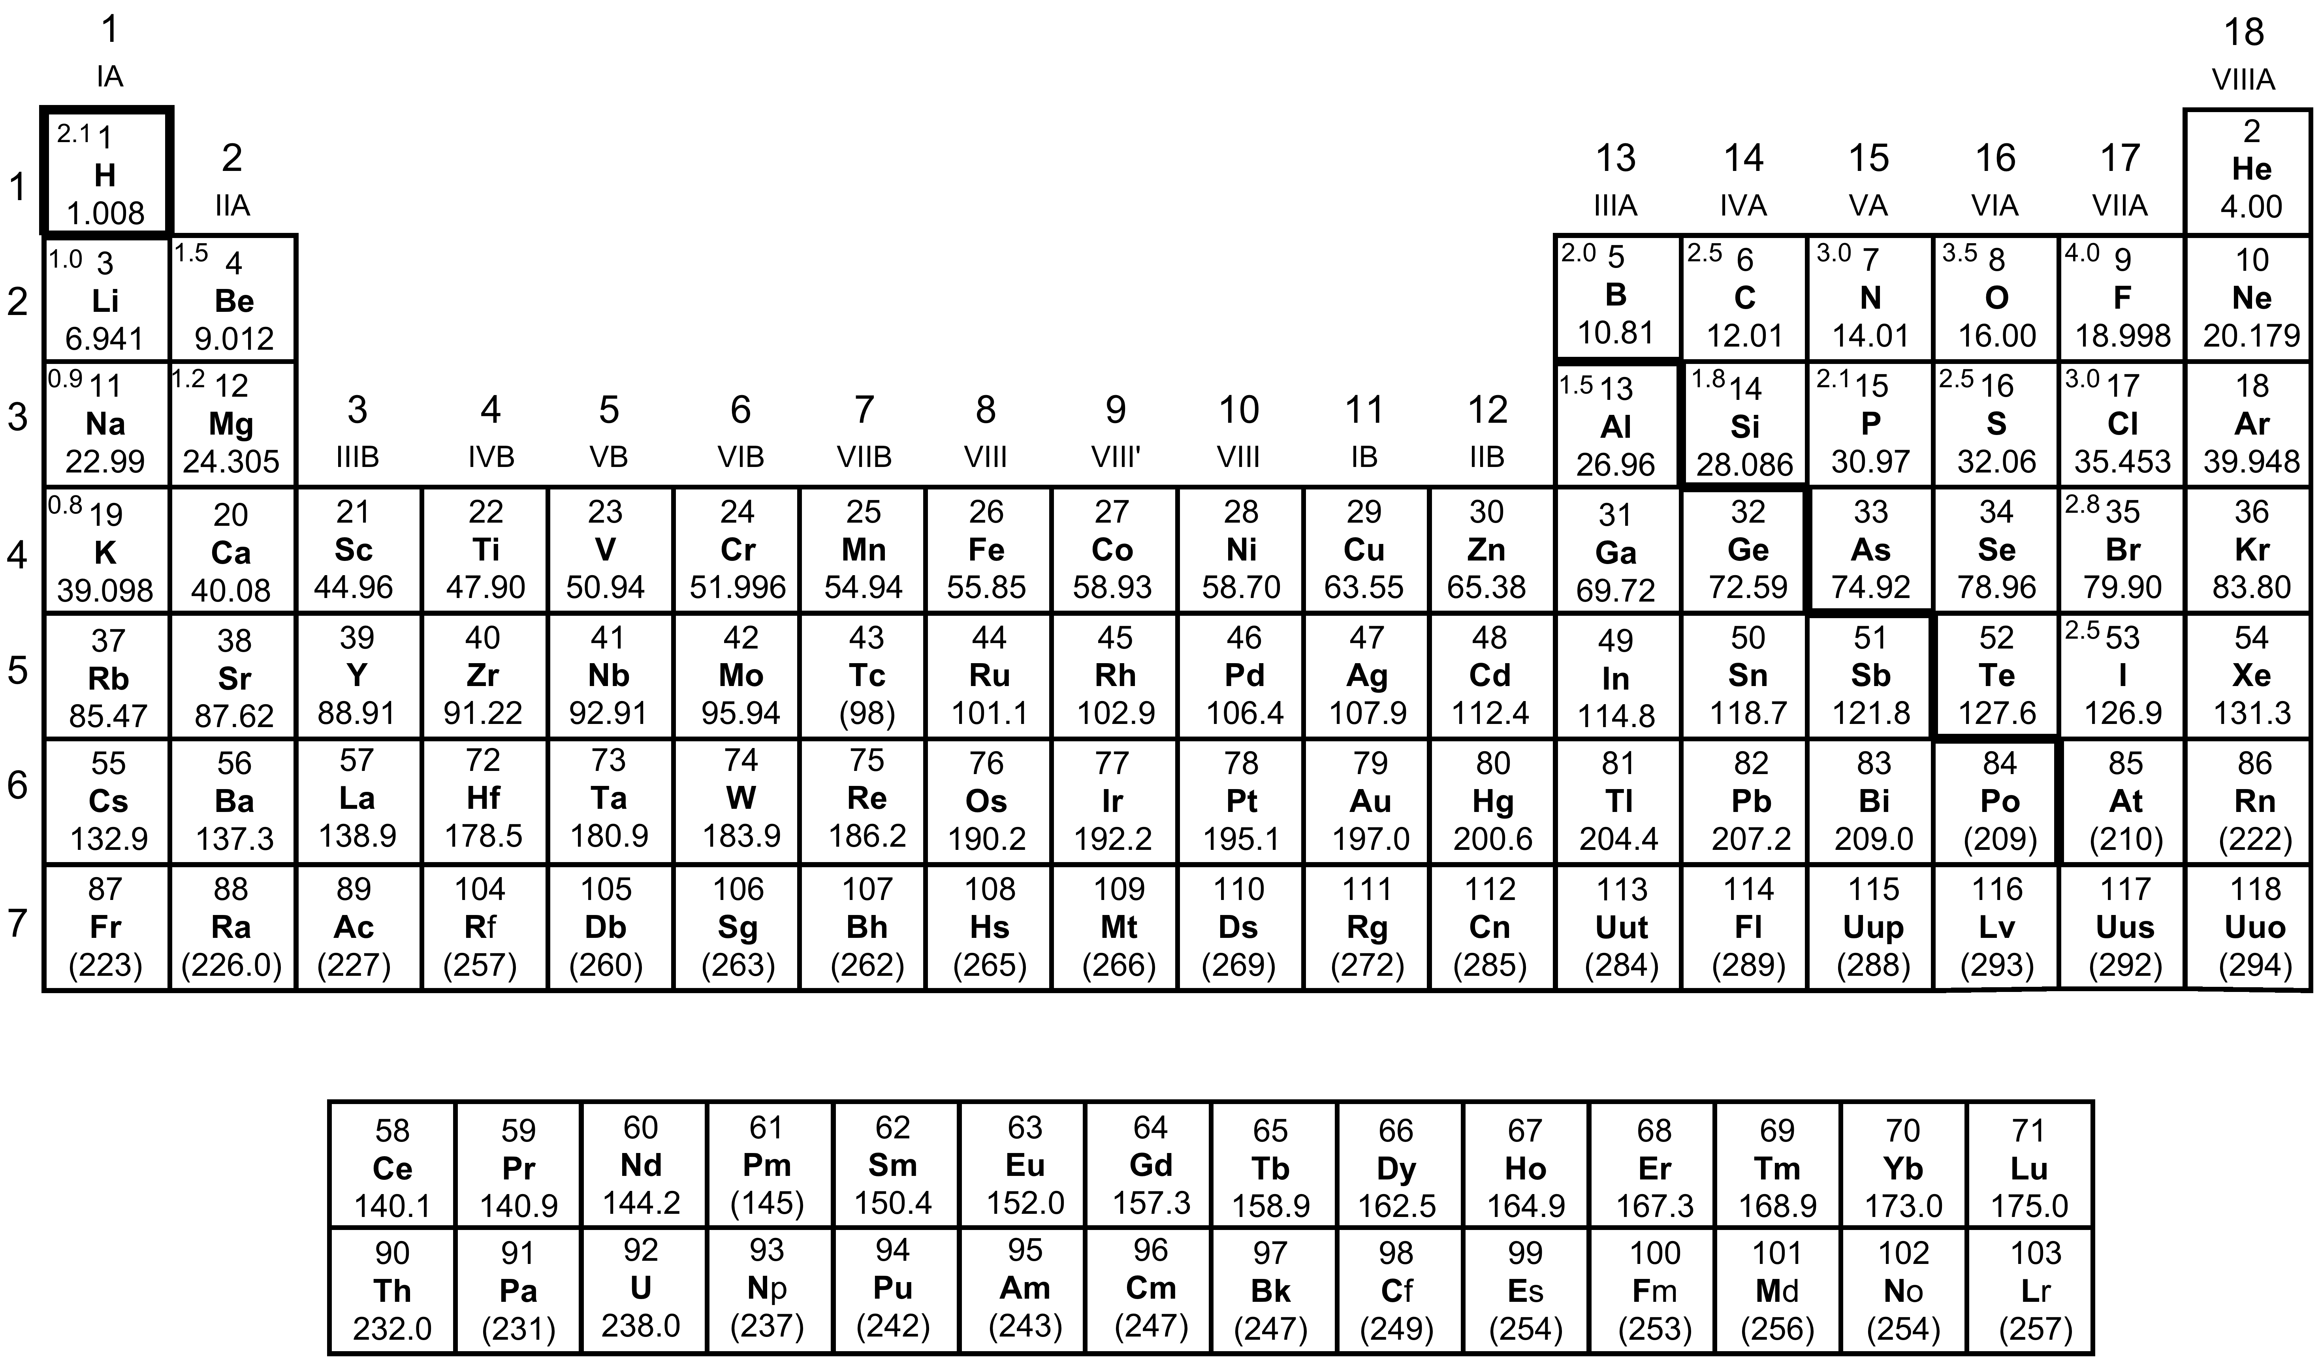
A Periodic Table of the Elements

Slide 23
A Periodic Table of the Elements
Hydrogen

Slide 24
A Periodic Table of the Elements
Alkali Metals

Slide 25
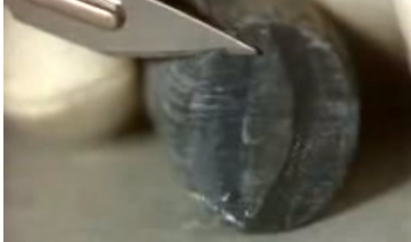
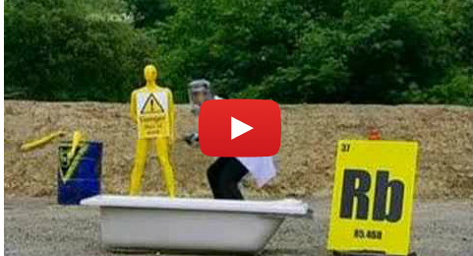
Alkali Metals
Highly Reactive Group (most reactive metals)
Like to “give away” 1 electron because outer orbital has one lone electron.
Not usually found alone in nature – found combined with other elements.
Solids at room temperature, but soft metals, can cut with a knife.

Slide 26
A Periodic Table of the Elements
Alkaline Earth Metals

Slide 27
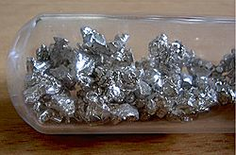
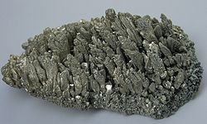
Alkaline Earth Metals
Very Reactive Group
Like to “give away” 2 electrons because outer orbital has two lone electron.
Not usually found alone in nature – found combined with other elements.
Harder and denser.
Higher Boiling Points.
Calcium
Magnesium

Slide 28
A Periodic Table of the Elements
Boron Family

Slide 29
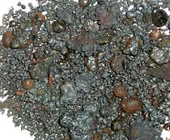
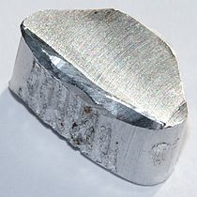
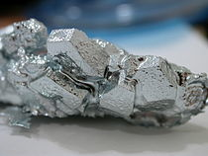
Boron Family
Group 13
Boron
3 electrons in outer “ring”
Like to “give up” electron
Boron is a metalloid
All the rest are metals- Aluminum, Gallium, Indium, and Thallium
Aluminum
Gallium

Slide 30
A Periodic Table of the Elements
Carbon Family

Slide 31
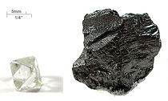
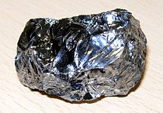
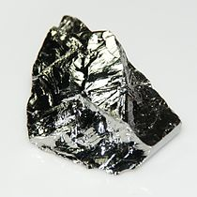
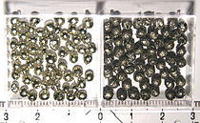
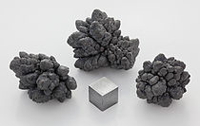
Carbon Family
Carbon
Group 14
4 electrons in the outermost “ring”
Non-metals: Carbon & Silcon (share electrons)
Metalloids: Silicon & Germanium
Metals: Tin & Lead (lose electrons)
Silicon
Germanium
Tin
Lead

Slide 32
A Periodic Table of the Elements
Nitrogen Family

Slide 33
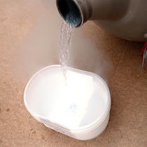

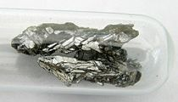
Nitrogen Family
Group 15
5 electrons in outermost “ring”.
Like to “share or take” 3 electrons
Group has metals, nonmetals, and metalloids.
Decrease in reactivity as you go down the column
Nitrogen
Phosphorus
Arsenic

Slide 34
A Periodic Table of the Elements
Chalcogens

Slide 35
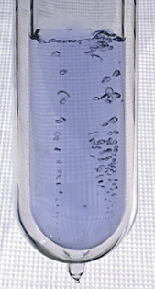
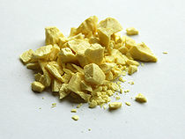
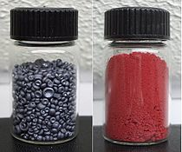
Chalcogens
Group 16 (Sometimes called Oxygen Group)
6 electrons in outer “ring”
Like to “take or share” 2 electrons
Decrease in reactivity as you go down the column
Oxygen
Sulfur
Selenium

Slide 36
A Periodic Table of the Elements
Halogens

Slide 37
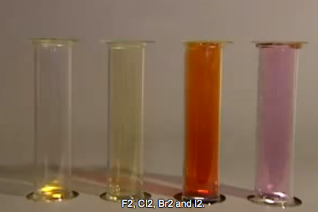
Halogens
Group 17
Outer shells are almost full. (Need 1 electron)
Very reactive
Fluorine (F), Chlorine (Cl), Bromine (Br), Iodine (I), Astatine (At)
“salt-formers”
Click to watch a You Tube About Halogens

Slide 38
A Periodic Table of the Elements
Noble Gases

Slide 39
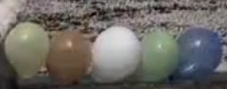
Noble Gases
Group 18 (XVIII)
“Happiest” elements of all.
Have full outer shells of eight electrons. (Except Helium which only has 2 but has a full shell with 2)
Non-reactive (Inert)
Helium (He), Neon (Ne), Argon (Ar), Krypton (Kr), Xenon (Xe), and Radon (Rn).
Stabilize Reactions quickly
Click to watch a Youtube about Noble Gases

Slide 40
A Periodic Table of the Elements
Main Group
or
Representative Elements

Slide 41
A Periodic Table of the Elements
Transition Elements

Slide 42
A Periodic Table of the Elements
Inner Transition or Rare Earth Elements

Slide 43
A Periodic Table of the Elements
Lanthanides

Slide 44
A Periodic Table of the Elements
Actinides

Slide 45
A Periodic Table of the Elements

Slide 46
Noble Gases (8e-)
Hydrogen
Main Group Elements
Chalcogens (6 e-)
Alkali Metals (1e-)
Nitrogen Family (5e-)
Halogens (7e-)
Alkaline Earth Metals (2e-)
Carbon Family (4e-)
Boron Family (3e-)
Transition Elements
Inner Transition or Rare Earth Elements
Lanthanides
Actinides
Click to hear the Periodic Table of Elements Song!!

Slide 47
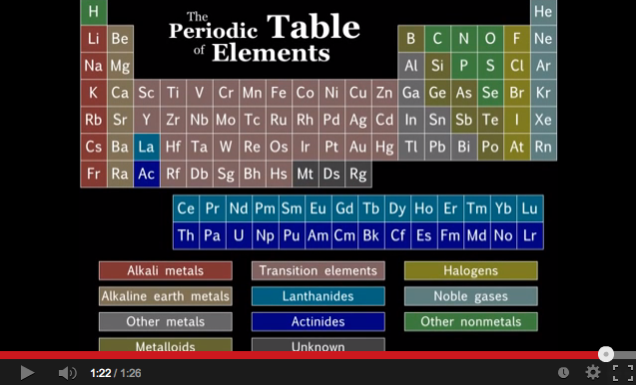

Slide 48
Open your Periodic Table Notes Document
Found in your Science Folder…
Type in these extra notes….

Slide 49
Valence Electrons
Valence Electron- electrons in the outer “ring” or shell of an atom.
  Valence electrons are important for chemical reactions and bonding as well as reactivity.
  Elements in the same group will have the same number of valence electrons.
  Each period has more energy levels or “rings” of electrons.

Slide 50
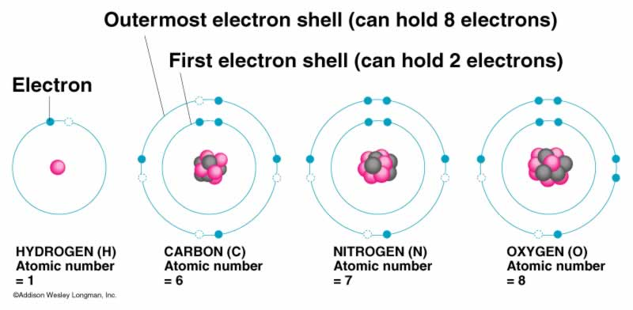
How many Valence Electrons in each atom?
1
4
5
6
Notice that the atomic number and the number of valence electrons are NOT Equal.
Atomic Number stands for the number of protons.
If the atom is uncharged (Not an Ion) the number of protons = the number of electrons.

Slide 51
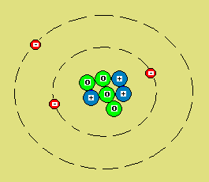
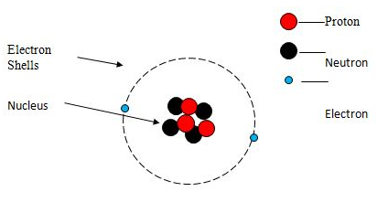
Ion or Neutral Atom?
Neutral Atom
Ion

Slide 52
Properties of Matter Review
Click Title to View Movie and Take a Quiz
Physical Properties
Chemical Properties
Characteristics of a substance that don’t result in a new substance
  Size: Mass and volume
  Density
  Melting Point/Boiling Point
  Color
  Malleability
  Ductility
Characteristics that help to explain how substances result in new substances.
Goes with Chemical changes.
  Flammability
  Reactivity
    Water?
    Acid? Base?
    Air?
    Highly Reactive? Inert?
  Corrosiveness
  pH

Slide 53
Resources:
For more information feel free to visit…
Chem4kids
Interactives: Periodic Table
Wikipedia
Webelements
Ptable
Photographic Periodic Table
Jefferson Lab: Periodic Table

