Slide 1
Matter
Notes and Review
K. Spence

Slide 2
Essential Questions:
How is matter organized?
How does matter differ in composition and properties?
What methods and properties are used to organize matter?
How can you differentiate between types of matter quantitatively and qualitatively?
How can the properties or composition of matter change?

Slide 3
Objectives:
Students will be able to:
Define and describe matter and its different states
Investigate and classify properties of matter.
Explain how properties of matter are determined.
Distinguish one substance from others based on physical and chemical properties.

Slide 4
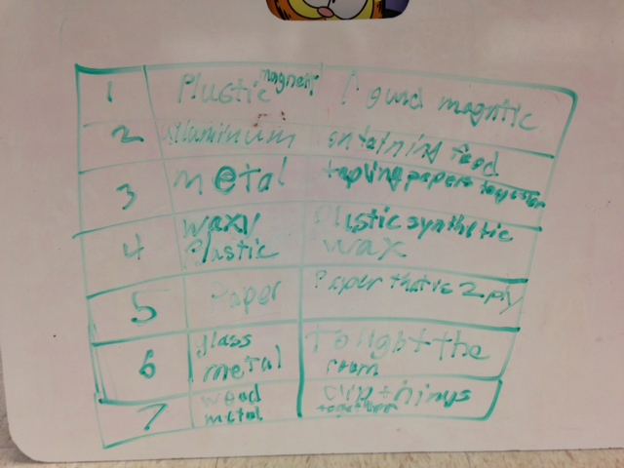

Slide 5
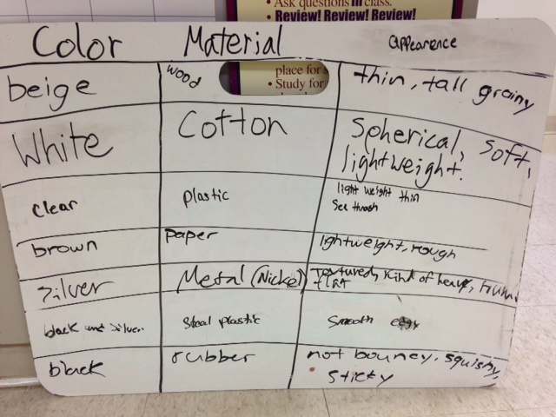

Slide 6
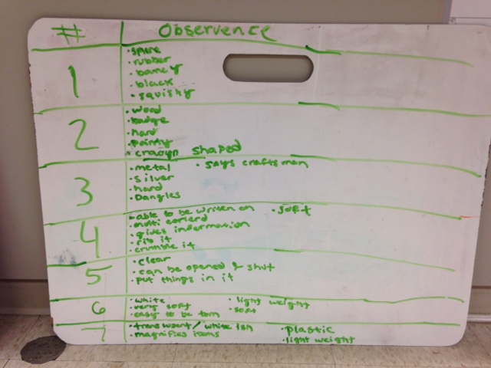

Slide 7
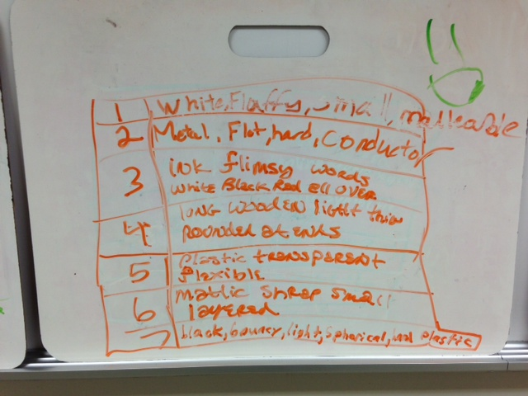

Slide 8
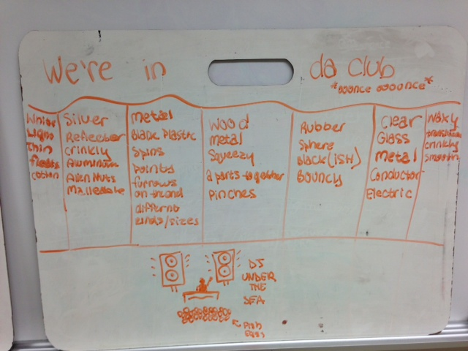

Slide 9
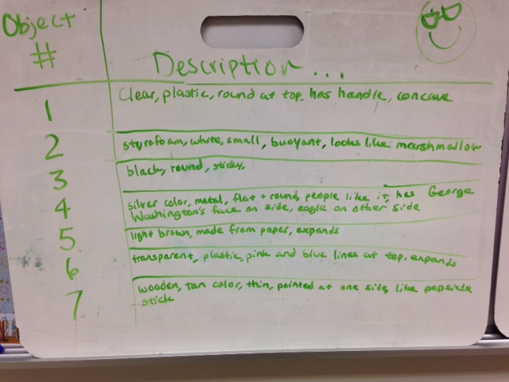

Slide 10
What are some properties of Matter?- Activity
Tasks:
Make a Data Table on your whiteboard. You will record the item # and its properties.
Carefully observe the objects you were given.
Describe each objects’ properties as clearly as possible. Avoid names, what they do, or how they are used.

Slide 11
Post-Lab Questions
What were some properties that seemed to make one description better than another?
Which properties were relative properties?
What were some examples of properties that are absolute properties?
What objects have one property that makes them very distinctive?

Slide 12
Describing Matter
Properties of Matter
Objectives:
Identify the properties of a variety of objects.
Classify objects by shared physical properties

Slide 13
Properties of Matter
Physical Properties
Chemical Properties
Properties seen or measured without changing the substance into something else.
Non-destructive Tests
Examples: color, taste, smell, size, melting point, boiling point, density, ductility, malleability, conductivity, solubility, state of matter
Properties that explain how the substance forms new substances when it react with something else.
Examples: flammability (heat of combustion), oxidation, pH, reactivity

Slide 14
Properties and Size
Macroscopic Properties
Microscopic Properties
Large scale properties
Seen or measured with “naked eye”
Determined directly
Small scale properties
Atomic or molecular level
Determined indirectly

Slide 15
Extensive vs. Intensive Properties
Extensive Properties
Intensive Properties
Depend on the amount of the substance
Examples: Mass, Volume, Length
Independent on the amount of the substance
Boiling Point, Melting Point, Color, Density

Slide 16
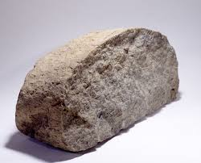
Review: What is Matter?
Matter- anything that has mass and takes up space (volume).
Matter can absorb or release energy.
Matter comes in 4 different states.

Slide 17
Review: States of Matter
Solids
Liquids
Gases
Definite shape and volume
Particles close together
Particles moving slowly(vibrating)
Not Compressible
Do not have a definite shape, but have a definite volume
Particles further apart
Take shape of container “pourable”
Particles moving faster
Not Compressible
No definite shape or volume
Particles spread out and move the fastest.
Fill large and small spaces
Takes shape of container
Compressible

Slide 18
Source: http://www.grc.nasa.gov/WWW/k-12/airplane/state.html

Slide 19
Review: Mass and Volume
MASS
VOLUME
Measures the amount of matter.
More matter = More mass
Different than Weight.
Tools: Balance (Pan, Triple-Beam, Electronic)
Units: gram (g)
Measures the capacity of the matter, or amount of space it takes up.
Liquids measured in milliliters (ml).
Regular solids measured in cubic centimeters (cm³)
l x w x h = Vol.
Irregular solids measured by displacement method. (ml)

Slide 20
Review: Density and Weight
Density- the amount of matter in a given space.
Mass per Volume
Density = mass/volume
Density of objects can determine floating vs. sinking.
Density can be used to identify materials or substances.
Weight- measure of the pull of gravity on an object.
Mass stays the same no matter where you are.
You are made of only a certain amount of matter, but the pull of gravity on Earth is more than on the Moon.
Therefore you weigh more on Earth than the Moon.
Weight is measured with a spring scale. Unit- Newtons

