Slide 1
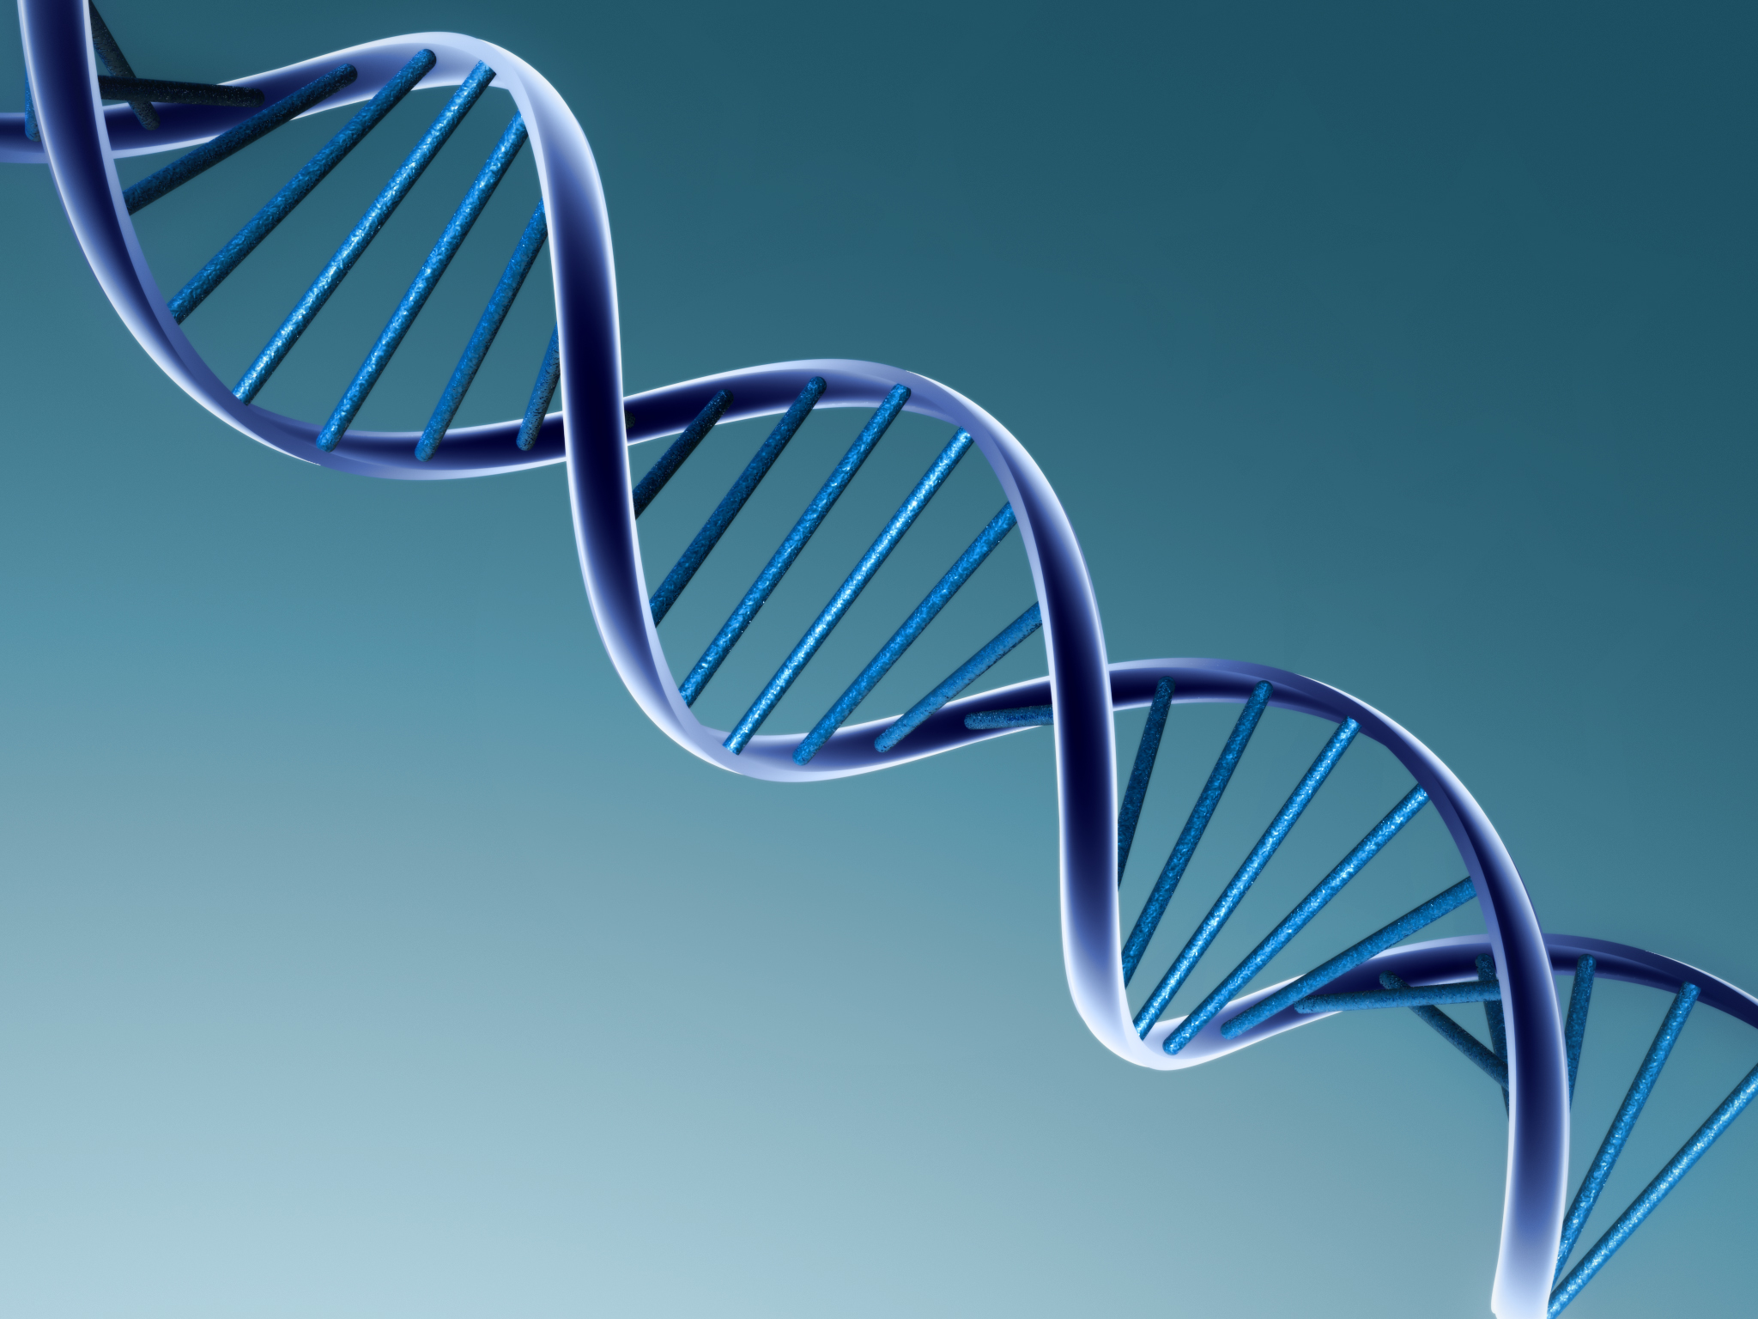
DNA Web Quest and Extraction

Slide 2
Tour the Basics
1. DNA is the genetic blueprint or instructions for building parts of cells and organisms.
2. DNA is inside cells inside the nucleus.
3. The shape of DNA is called a double helix.

Slide 3
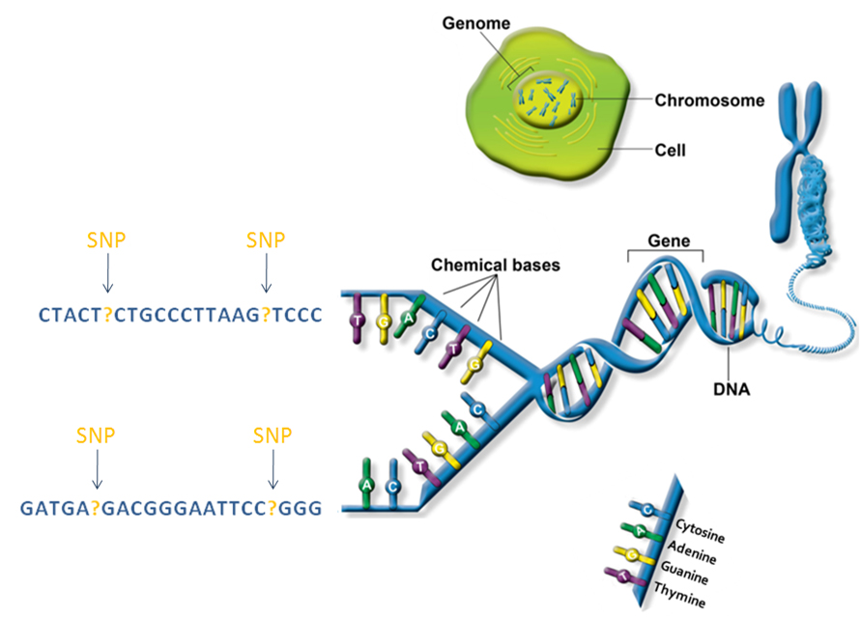

Slide 4
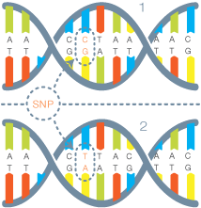
4. Sugar-Phosphate Backbone and Nitrogen bases
Adenine pairs with Thymine
(A – T)
Cytosine pairs with Guanine
(C – G)
5. The nitrogen bases make a “Sentence” that codes for a certain molecule called a protein. Proteins let cells do certain functions or give certain characteristics.

Slide 5
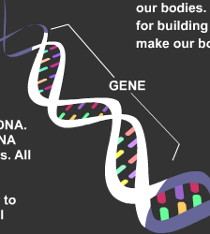
6. A gene is a section of DNA that codes for a certain trait. One section of DNA that gives instructions for your body.
7. A mutation is a change in a gene.
Mutations are caused by a change in the DNA code.
Ex. Sickle Cell Anemia is caused by a Mutation.

Slide 6
8. A chromosome is DNA and proteins packed tightly together.
9. Chromosomes are made of DNA. We have 2-3 m of DNA in each cell of our body.
10. Females have two X- chromosomes. Males have an X and a Y chromosome.
11. Different organisms have different number of chromosomes. Humans have 23 pairs of chromosomes or 46 total.

Slide 7
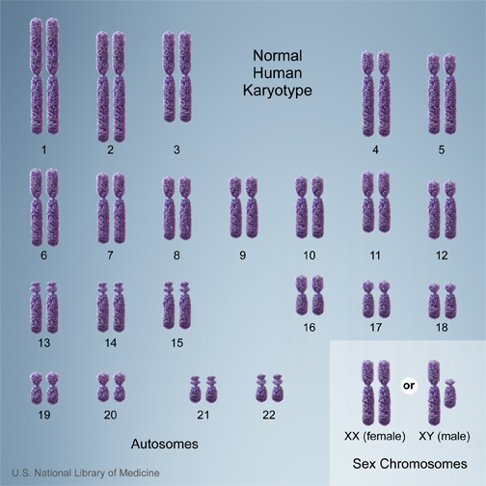

Slide 8
12. What are Proteins?
Proteins are long chains of amino acids that help the body to function. Proteins are the non-living building blocks in our bodies.
13. How do proteins help you preform bodily functions?
Proteins help to determine the traits of living things and build cells, tissues. Each protein helps your body to run like each part of an engine helps a car to run.

Slide 9
14. How are proteins made? (give the steps)
Genes are read,
DNA is copied into RNA,
RNA moves into the cytoplasm and goes to the ribosome,
The ribosome reads the message and makes the protein according to the instructions.

Slide 10
15. What is heredity?
The passing of traits from parents to offspring.
16. What is a trait? Give some examples.
A feature or quality in an individual.
Physical trait- eye color, hair color, height
Behaviorial trait- Retriever’s instinct to fetch
Predisposition to medical condition- Sickle Cell, Cystic fibrosis, some cancers, heart disease etc.

Slide 11
17. How does the environment work with our DNA?
Physical Traits-Hair color can be dyed, or sun can change the color.
Behavioral Traits- Training a dog or the way your life has gone makes you a unique and different person.
Predisposition to Diseases- Healthy eating and exercise can decrease the risk of certain diseases.

Slide 12
20. Put the following in order from smallest to largest: (chromosome, cell, DNA, gene, nucleus, ribosome).
Gene, DNA, Chromosome, Ribosome, Nucleus,

Slide 13
18. Find out how DNA is Replicated. Write the steps to explain the process.
19. Find out how DNA is used to make proteins. What are the steps for protein synthesis?

Slide 14
Exit Slip 4/8
What process makes new sex cells?
What process makes new body cells?
How is the DNA different in those two processes?
What is the shape of DNA?
What is a section of DNA called?
How does DNA determine the traits you have?
The passing of traits from parent to offspring is called?

Slide 15
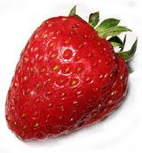
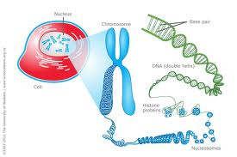
DNA Extraction- Strawberries

Slide 16
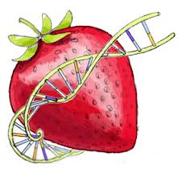
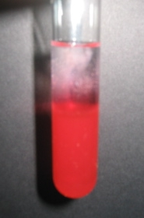
Materials
1 strawberry, in Ziploc Baggie
10 mL Extraction buffer
About 20 mL ice cold 91% isopropyl alcohol
1 clear test tube
1 funnel lined with gauze
1 pipette/popsicle stick

Slide 17
Directions
Remove the green sepals from the strawberry and give it a quick rinse.
Place strawberry in baggie, let the air out of the bag and zip it closed. BE SURE IT IS CLOSED!!!
Squish for a few minutes to completely squash the fruit.
Add 10 mL of DNA buffer and squish for another minute. TRY NOT TO MAKE BUBBLES!!!
Place Funnel in the top of the test tube. Place gauze in funnel.
Have one person hold the funnel while the other carefully pours the contents of baggie into the funnel. Do not squeeze the gauze. The liquid should go into the test tube.

Slide 18
Pour alcohol carefully down the side of the tube so that it forms a separate layer on top of the strawberry liquid. You don’t have to use it all.
Watch for several minutes. What do you see? You should see stringy, white fluffy cloud between the two liquids. That is the DNA.
You can use the pipette or stick to gently tangle the DNA and take it out of the test tube.
CLEAN UP:
Throw out the gauze, baggie and left over strawberries.
Rinse out the funnel and test tube.
Place all tools on your desk. Clean off the desk with sponge/paper towel.
Answer the post lab questions.

