Slide 1
Matter Atoms to Molecules
Notes and Review
K. Spence

Slide 2
Go to SWS
Download and Save-
Matter Vocab Chart in Science Folder
Leave document open so we can use it today.
Did you “Post Live” on your Science Blog??

Slide 3
Open
Matter Vocab Chart in Science Folder.
Atoms to Molecule Article
Did you “Post Live” on your Science Blog??

Slide 4
Essential Questions:
How is matter organized/classified?
How do atoms and elements combine?

Slide 5
Objectives:
Students will be able to:
Distinguish between atoms, elements, molecules, compounds, mixtures and solutions.
Explain how atoms and elements are organized.
Examine how atoms determine properties of matter.
Describe substances and classify according to their properties.

Slide 6
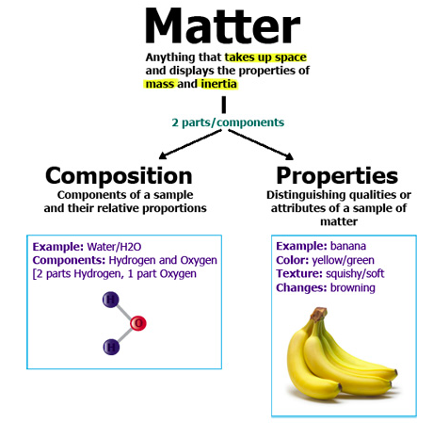
Matter- any substance that takes up space and has volume.
Examples: Organisms, Minerals, Rocks, Pencils,
Non-examples: Energy, Temperature, Heat, Light, Sound, Fire

Slide 7
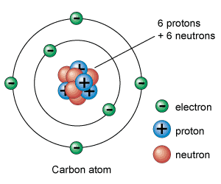
Atom-basic unit of matter
Contains 3 sub-atomic particles:
Proton- positively charged particle in nucleus
Neutron- neutral particle in nucleus
Electron- negative particle orbiting nucleus
Atomic Mass-mass of an atom; protons + neutrons.

Slide 8
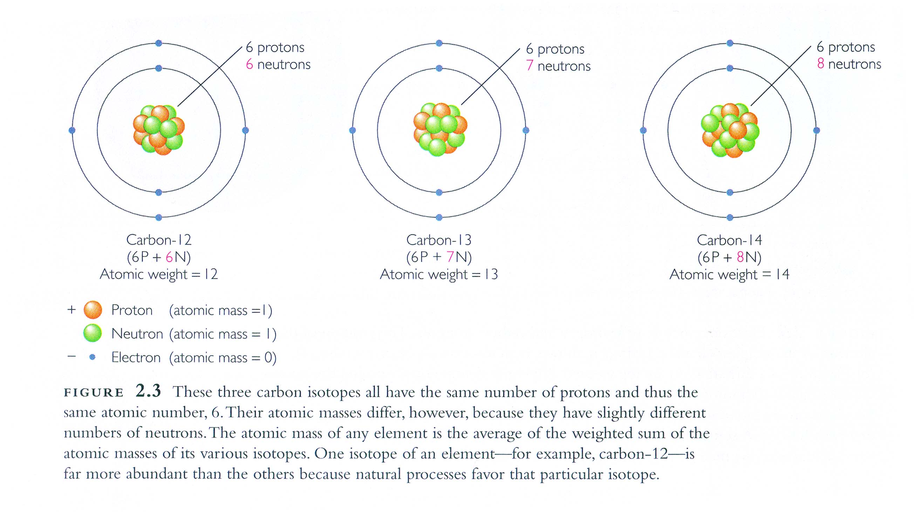
Isotope- a version of an element with a different number of neutrons.

Slide 9
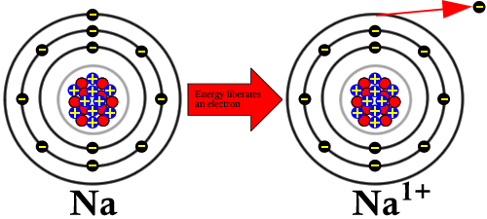
Ion- charged atom
Example:
Sodium (Na)
11 protons
+ 11 electrons
0 charge
Sodium Ion (Na ¹⁺)
11 protons
+ 10 electrons (one electron lost)
1 proton = +1 charge

Slide 11
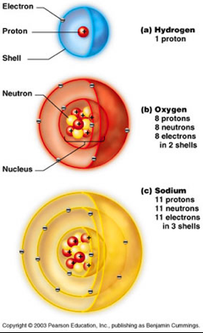
What are unique atoms called?
Element- substance made of only one particular kind of atom
Each element has a unique number of protons, neutrons, and electrons.
Elements are organized…more on this tomorrow.

Slide 12
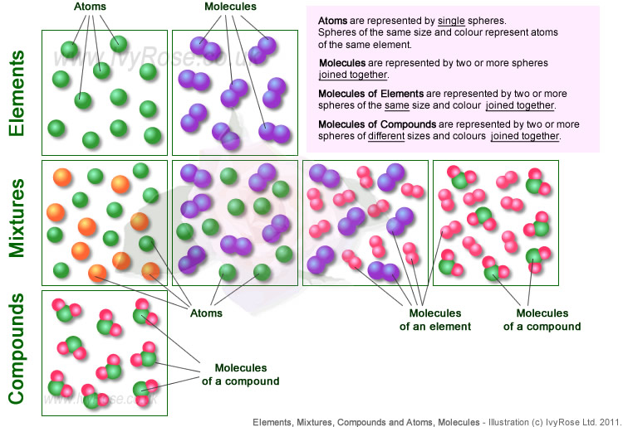
How do atoms combine?

Slide 13
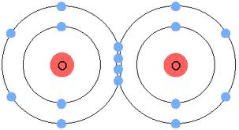
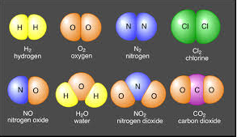
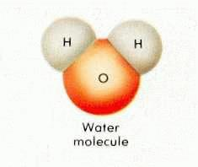
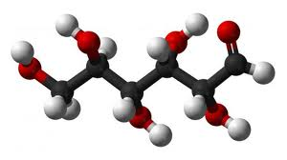
How do atoms and elements join?
Molecule-a substance of two or more bonded atoms.
Compound- substance of two or more different elements.

Slide 14
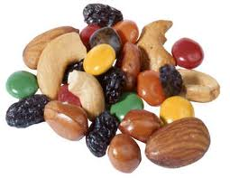
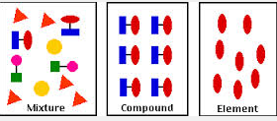
Mixture- combination of substances in which the atoms of the substances are not chemically combined.
Can be separated by physical means.

Slide 15
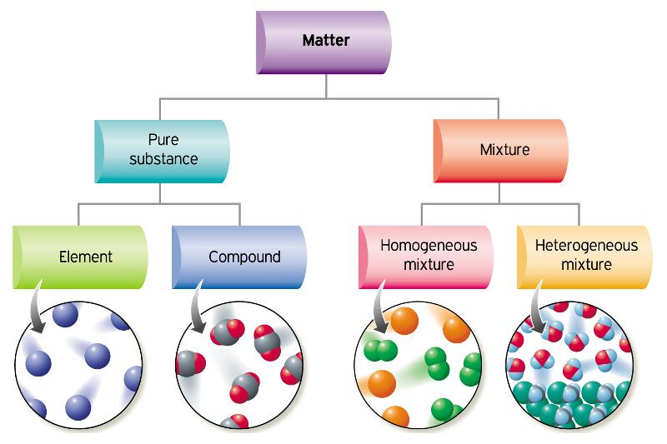

Slide 16
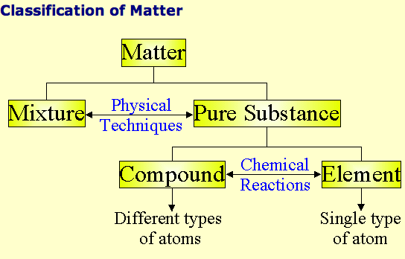

Slide 17
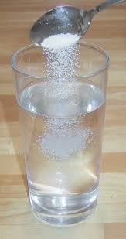
What about dissolving?
Solution- when one substance dissolves into another.
Solute- the substance that is dissolved
Solvent- the substance in which the solute is dissolved.

Slide 18
Entrance Slip- 9/25 Write the word that matches each definition. Use the lined side of the note card.
The smallest, basic unit of matter.
The number of protons and neutrons in an atom.
Charged atom
Two or more bonded atoms
Version of an element with a different number of neutrons
Any item that takes up space and has mass

Slide 19
Entrance Slip- 9/24 (Answers)
The smallest, basic unit of matter.- Atom
The number of protons and neutrons in an atom. – Atomic Mass
Charged atom - Ion
Two or more bonded atoms - Molecule
Version of an element with a different number of neutrons - Isotope
Any item that takes up space and has mass - Matter

Slide 20
Review: Classify each of the following as elements, compounds, mixtures or none.
Diamond (C)
Air
Water (H₂O)
Ammonia (NH₃)
Bronze
Pail of Garbage
Energy
Chlorine (Cl₂)
Milk
Baking Soda (NaHCO₃)

Slide 21
Review: Classify each of the following as elements, compounds, mixtures or none.
Diamond (C)- Element
Air- Mixture
Water (H₂O)-Compound
Ammonia (NH₃)-Compound
Bronze-Element
Pail of Garbage- Mixture
Energy- None
Chlorine (Cl₂)- Compound (Molecule)
Milk- Mixture
Baking Soda (NaHCO₃)-Compound

Slide 22
Element- Fundamental substances that cannot be broken down into simpler substances by normal chemical reactions.
118 known elements
92 Naturally occurring elements
No Unknown elements under 110
Earth’s Crust Human Body
O 49.5% O 65%
Si 25.7% C 18%
Al 7.5% H 10%
Fe 4.7%
Symbols: From Latin, Greek, or German
Always capitalize 1st Letter

Slide 23
How would you organize so many elements?
Trends Activity
And
Mendeleyev Challenge

Slide 24
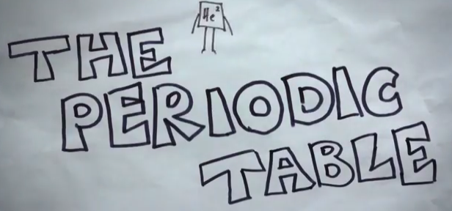
History of the Periodic Table - Youtube

Slide 25
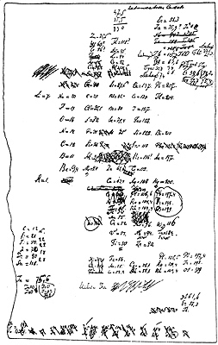
Periodic Table of Elements
A draft of Mendeleev’s first periodic table created in February 1869.
Lothar Meyer also published a table in 1870 but did not predict the existence of undiscovered elements.

Slide 26
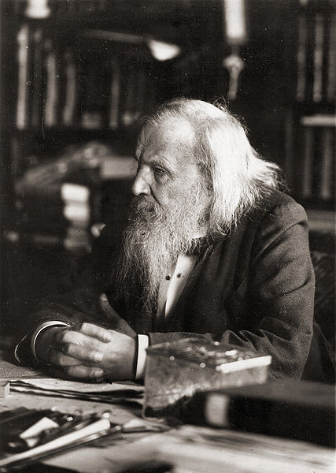
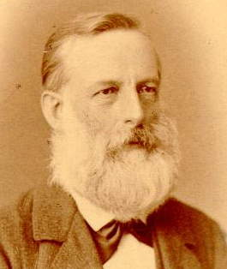
Periodic Table of Elements
Dmitri Mendeleev
Lothar Meyer

Slide 27
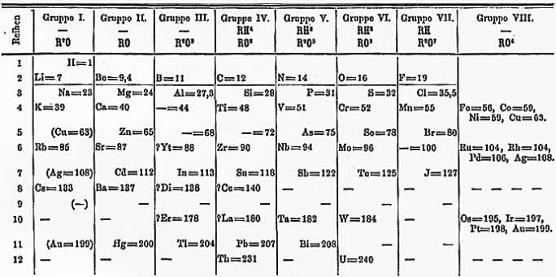
Periodic Table of Elements
Mendeleev’s first periodic table published in Zeitschrift für Chemie 12, 406-6 (1869)

Slide 28
Importance of Mendeleev’s Table- Youtube

Slide 29
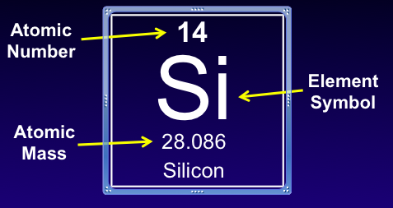
Modification to Mendeleev’s Table:
All atoms of the same element contain the same number of protons.
Atomic Number- number of protons in an atom.

