Slide 1
The Atmosphere

Slide 2
Key Vocabulary
Altitude- elevation or distance above sea level
Temperature- a measure of heat energy in an item
Water Vapor- water in the form of a gas
Pressure- the force pushing on an area or surface
Particles- solids such as dust, smoke, salt, pollen, chemicals, cells etc.
Weather- a condition of the Earth’s atmosphere at a particular place and time
Climate- the overall, average or expected weather patterns in an area.

Slide 3
Composition of the Atmosphere
Atmosphere- the layer of gases that surround the planet
Made of nitrogen, oxygen, carbon dioxide, water vapor, other gases, and particles
78% Nitrogen
21% Oxygen
3 jobs of the atmosphere
Makes Earth inhabitable
Traps energy to help heat the Earth.
Protects us

Slide 4
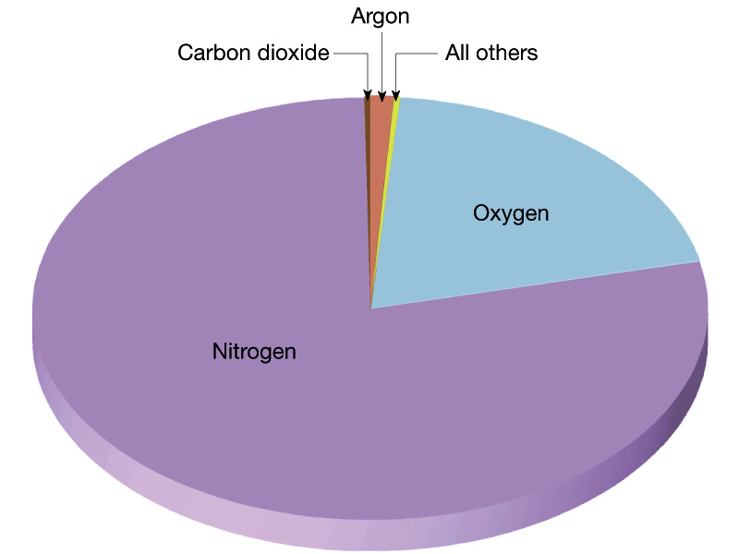

Slide 5
Layers in the Atmosphere
Troposphere- “tropo-” means changing
Lowest layer, ground level to 12 km high
Contains Earth’s weather
Where we live
Stratosphere- “strato-” means layer
Next highest layer, 12-50 km
Contains the Ozone layer
Absorbs UV rays from the Sun
Commercial jets fly here, few clouds, dry

Slide 6
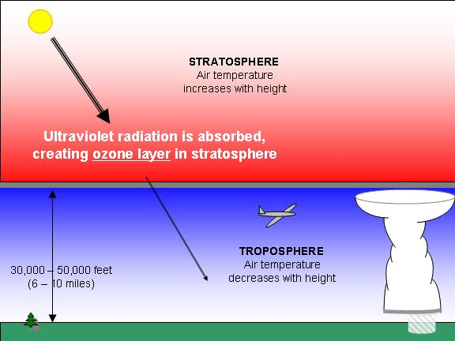
Ozone Layer
Ozone is a pale blue gas, with a strong odor: O₃
We breathe Oxygen O₂
90% of all the Ozone is found in the stratosphere. 10% is found in the troposphere.
Ozone is extremely important because it is the only gas that absorbs ultraviolet radiation from the Sun and protects the surface of the Earth and people from the damaging effects of UV rays.

Slide 7
Layers in the Atmosphere cont’d
Mesosphere- “meso-” means middle
50-80 km
Coldest part of the atmosphere
Meteoroids burn up in this layer (shooting stars)
Hard layer to study
Thermosphere- “thermo-” means heat
Top layer, 80 km and outward (no outer limit)
Layer most exposed to the Sun, Hottest layer
Divided into two additional layers (Ionosphere and Exosphere)
Ionosphere- 80-550 km, radio waves bounce off of electrically charged molecules, contains Aurora Borealis
Exosphere- above 550 km, satellites orbit here

Slide 8
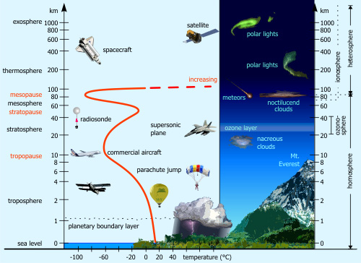

Slide 9
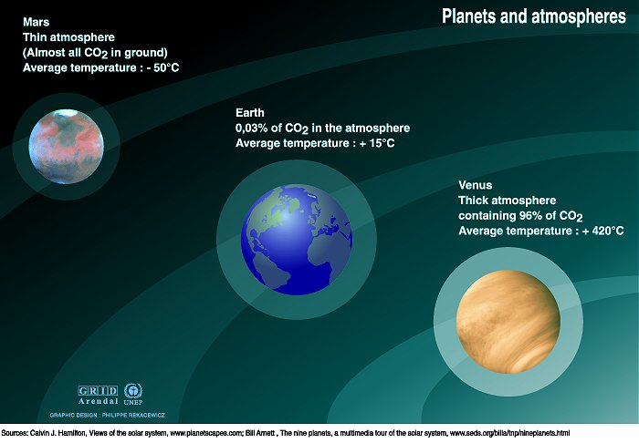

Slide 10
Energy in the Atmosphere
Electromagnetic waves- a form of energy that can travel through space.
Some of the energy from the sun is reflected and absorbed in the atmosphere.
Most of the energy that reaches in the Earth is visible light, infrared radiation, or small amount of UV radiation.

Slide 11
Kinds of Radiation
Visible Light- mixture of all colors of light in the rainbow (ROYGBIV)
Infrared- form of energy with wavelengths that are longer than red light (EX: Food prep)
Ultraviolet (UV)- a form of energy with wavelengths that are shorter than violet light (EX: Causes damage to DNA or cells)

Slide 12
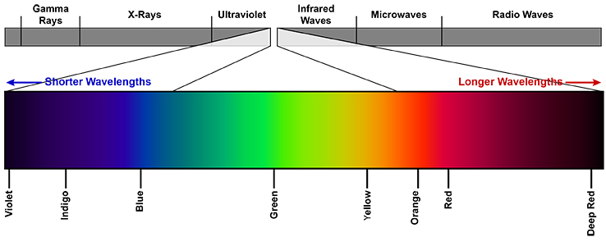
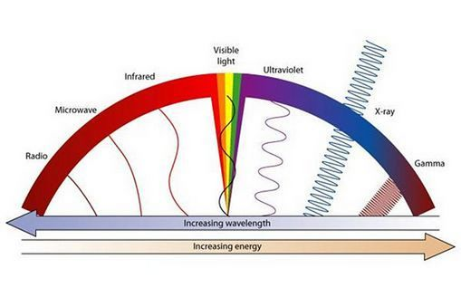

Slide 13
Today’s Tasks
Put your stapled Genetic Research Paper in the Bin. (If you gave it to Mrs. Goodman that is ok go to the next step.)
Go to SWS: Daily Assignment, Copy today’s assignment and Paste at the end of the Atmosphere Notes from yesterday.
Complete #1-4 from what you pasted.
We will start talking about the following questions in about 15-20 minutes.

Slide 14
Greenhouse Effect
Greenhouse Effect- process by which gases in the atmosphere hold in heat
Humans have impacted the natural greenhouse effect by adding to the amount of greenhouse gases. That increases the temperature on Earth.
Greenhouse gasses are Carbon Dioxide, Water Vapor, Methane, and Nitrous Oxide.
Humans have also released chemicals that have decreased the size of the ozone layer. (Made a hole)

Slide 15
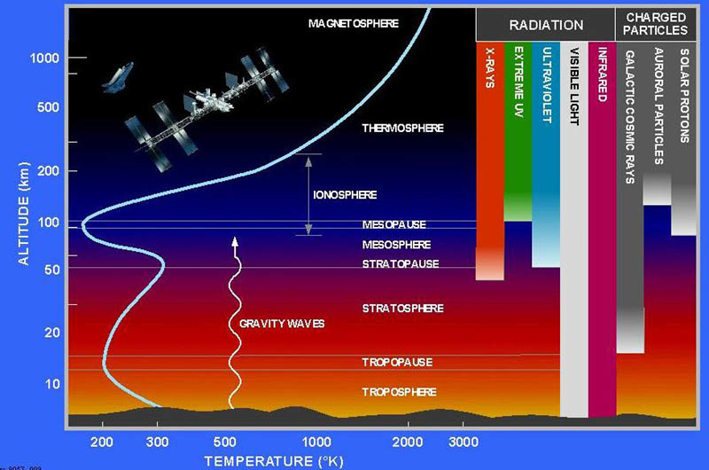

Slide 16
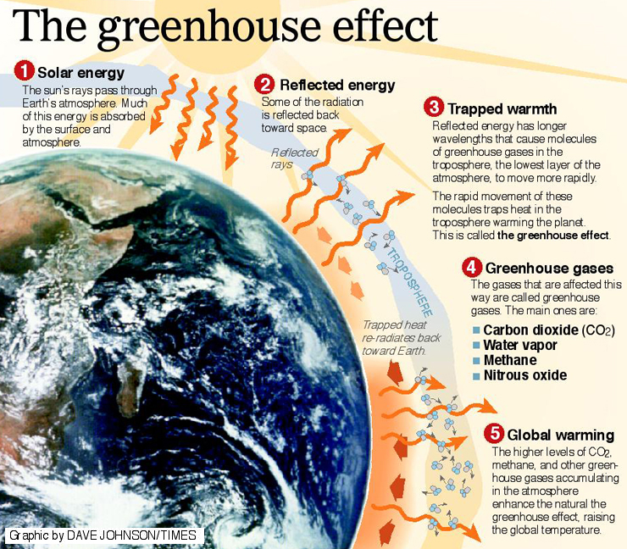

Slide 17
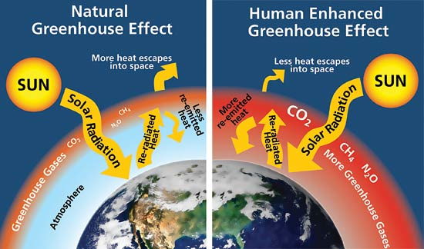

Slide 18
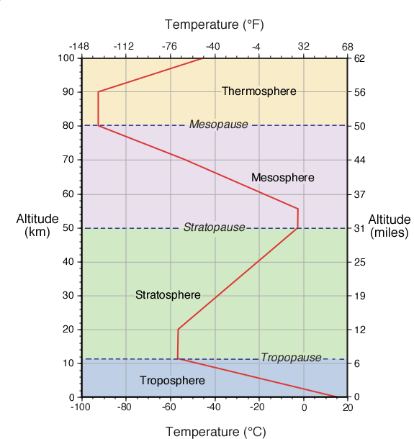
What happens to the temperature as you increase in altitude in the Troposphere?
In the Stratosphere?
In the Mesosphere?
In the Thermosphere?

Slide 19
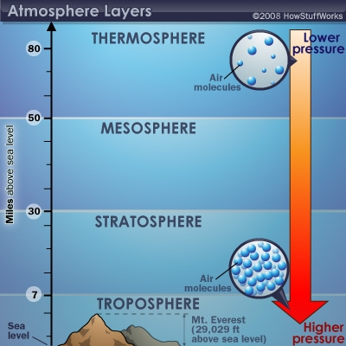
What happens to the pressure as you increase in altitude from the troposphere to the thermosphere?

Slide 20
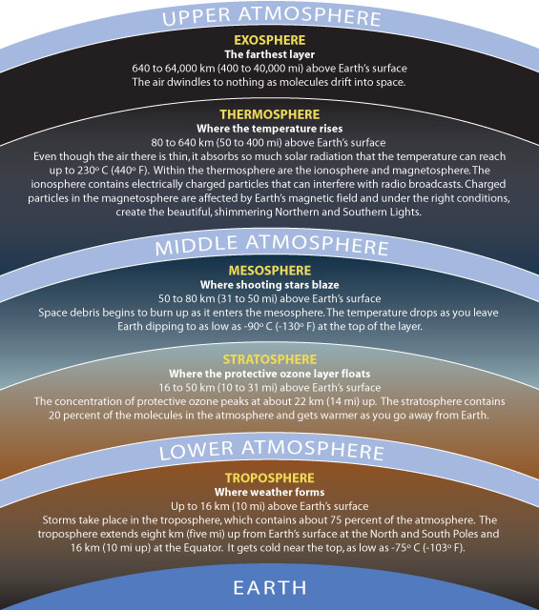

Slide 21
Exit Slip
Word Bank: Atmosphere, Mesosphere, Thermosphere, Stratosphere, Troposphere, Ozone Layer
In which part of the atmosphere does most weather occur?
What part of the atmosphere shields Earth’s surface from harmful UV radiation?
What is the outermost layer called?
In which layer do we live and spend most our time?
Which layer is the hardest to study? Why?
What is the most abundant gas in the Earth’s atmosphere?
Why are the thermosphere and exosphere the warmest layers?

Slide 22
Heating the Atmosphere
Thermal Energy- the total energy of motion in the molecules of a substance
Temperature- the average amount of energy of motion of each molecule of a substance
Thermometer- tool used to measure the average amount of energy of motion (temperature)
Heat- energy transferred from a hotter object to a cooler object

Slide 23
There are 3 ways Heat is transferred
Radiation- the direct transfer of energy by electromagnet waves
Ex- Sunlight shining on Earth
Conduction- the direct transfer of heat from one substance to another substance that is touching
Ex- Items on ground getting warm because they sit on the ground
Convection- the transfer of heat by the movement of a fluid
Ex- Air above ground warming due to heat in ground.

Slide 24
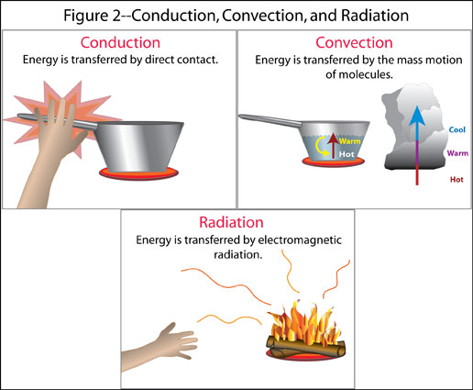

Slide 25
Lab Results and Discussion
1. When you placed the thermometer directly on the ground what kind of heat transfer was taking place?
When you placed the thermometer 1.25m above the ground what kind of heat transfer was taking place?
What kind of transfer occurred for your skin to feel warm?
2. How did the temperature 1 cm above the ground compare to the temperature 1.25 m above?
3. Are there differences between your two locations? Explain. Why do you think that was or was not the case?

Slide 26
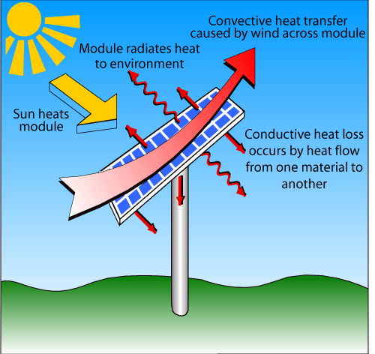

Slide 27
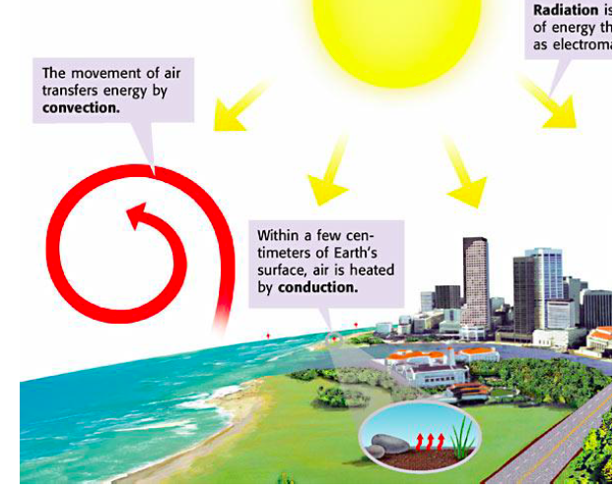

Slide 29
4. Predict the outcome of this experiment if you were 12 hours from now? Explain your Prediction using science terms.
5. What can you conclude about the temperature of the troposphere closer to the ground as opposed to further from the ground?

Slide 31
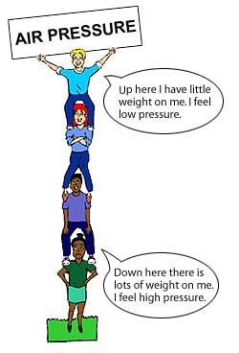
Air Pressure and Altitude

