Slide 1
Advances in Genetics
A Brief Overview with Questions

Slide 2
Advances in Genetics
Throughout the last 50 years there have been many advance in the field of genetics.
Most advances are due to increased technology.
We can now make copies of DNA, “read” the genetic code, and have found genes that specifically correspond to traits.
This presentation outlines just some of the major advances in genetics. You’ll research more about the debate that results from some of these advances.

Slide 3
This is not an exhaust list of Advances in Genetics, nor does it cover all the scientific, moral, ethical or legal issues. The following questions have no right or wrong answers but are questions society will have to answer as progress in genetic research continues.
Informed, educated persons will be the best at making these critical decisions.
The research you do will help you to become an informed on one topic of interest to you and ask you to take one side.

Slide 4
Karyotypes
Karyotypes are pictures of all the chromosomes in a cell.
Can be used to diagnosis some genetic disorders or tell male vs. female
Families with histories of genetic disorders might go to a genetic counselor
Genetic counselors help families understand the chances of children having particular genetic disorders.
Use Karyotypes, Punnett Squares, Pedigrees, DNA testing

Slide 5
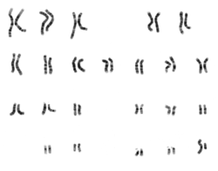
Karyotype example

Slide 6
Selective Breeding
Selective Breeding is a method of creating offspring that have specific desirable traits, as chosen by an individual.
Think: Selective= “we choose”
There are two techniques in selective breeding:
Inbreeding- crossing 2 individuals who have similar characteristics so that the offspring has the same “good characteristics.
Hybridization- crossing 2 genetically different individuals so that the resulting offspring has the best characteristics of each.

Slide 7
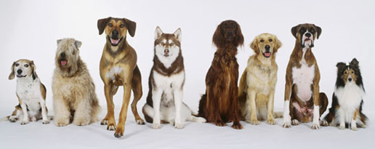
Selective Breeding Examples:
Inbreeding: Two pure-bred dogs with curly short brown fur => puppies with curly short brown fur.
Hybridization: Lab bred with a poodle => Labradoodle Labs are friendly family dogs, Poodles don’t shed. Labradoodles are the good mix of both.

Slide 8
Cloning
Cloning is a method of creating offspring that are genetically identical to one other organism.
Clones are common in nature: (Asexual reproduction)
Researchers have cloned animals (Sheep, pigs,) but human cloning is controversial.
Would it bring back a loved one or pet?
Would they be the exact same? Should clones be treated the same?
Do risks outweigh rewards? Clones don’t live as long and can have health problems.
Could you just clone body parts? (New organs to replace worn out ones?)

Slide 9
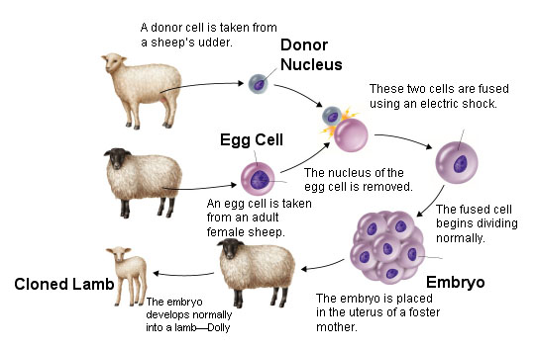
How to Clone a Sheep: Dolly

Slide 10
Genetic Engineering
Genetic engineering is when desirable genes from one organism are transferred into the DNA of another organism.
Think about it “Kind of like what viruses do.”
Already done to make medicines, insulin, blood clotting proteins, or improve food crops.
Questions:
Is it right to use other organisms for human gain?
Are there side effects for the organism injected with DNA?
Are there limits to what could be produced?

Slide 11
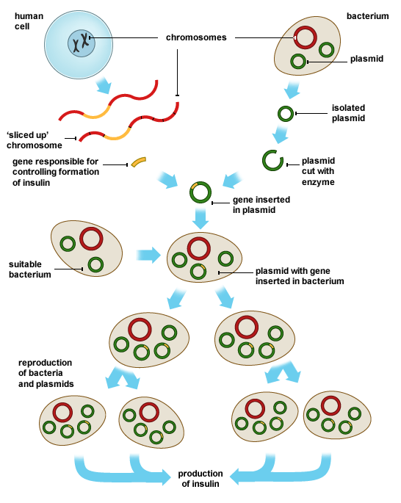
Genetic Engineering How to…

Slide 12
Gene Therapy
The use of genetic engineering to correct disorders in humans.
Insert copies of “good” genes into people with “bad or defective” genes.
This can already be done in some organisms.
Some kinds of cancer treatments are studying this possibility in more detail.
Questions:
Is it safe? Is it reliable? Can it be done?
Is there a limit to what genes we should “fix”? Genetic disorders? Hair color/eye color/skin color?
Is it right to fix all genes? Designer babies?
Are the risks worth the reward? Unintended consequences?

Slide 13
Human Genome Project
A long term research study done to identify the DNA sequence of every gene in the human genome.
Genome- all the DNA in one cell of an organism
Started in 1990 and Completed in April of 2003
All data was quickly and freely available on the Internet
Led to many other research studies and findings…many more to come

Slide 14
DNA Fingerprinting
Since everyone has their own unique combination of DNA (unless you are an identical twin), DNA can be used to identify a person, just like finger prints.
DNA fingerprinting is sometimes also called DNA testing, DNA profiling, or DNA/genetic typing.
Gives a unique view of a person.
Used in identifying missing persons, dead bodies, criminals identity, paternity, family connections etc.
Questions:
Should everyone be required to give a DNA sample or only in some cases?
What do you do about twins?
Should your DNA be patented/protected?

Slide 15
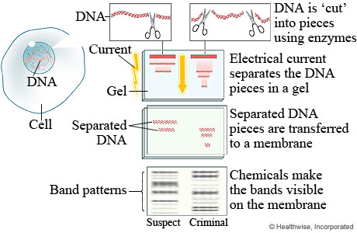
How DNA Fingerprinting works…

Slide 16
What other questions do you have about these or other genetic advances? They can be science related, moral, ethical, or other types of questions.
Write 3 questions in your notes to ask others in class.

Slide 17
Genetic Issues you can Research…
Animal Cloning
Anonymous Egg/Sperm Donors
Biomedical Technology
Genetic Engineering
Genetically Modified Foods
Human Cloning
Prenatal Testing
Stem Cells
Other- Requires conference with me.
We’ll talk more about this on Thursday.

